Slide 2
We Transform Data into Stories and Insight

Slide 3
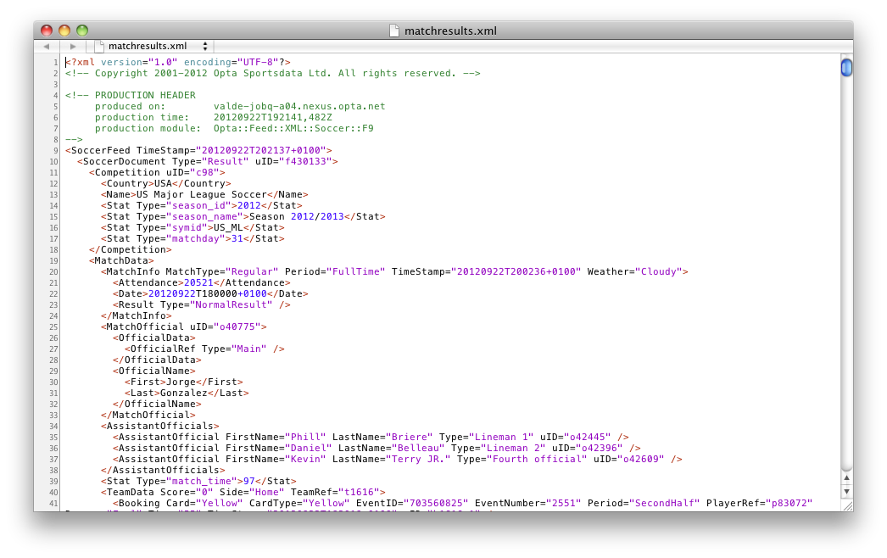


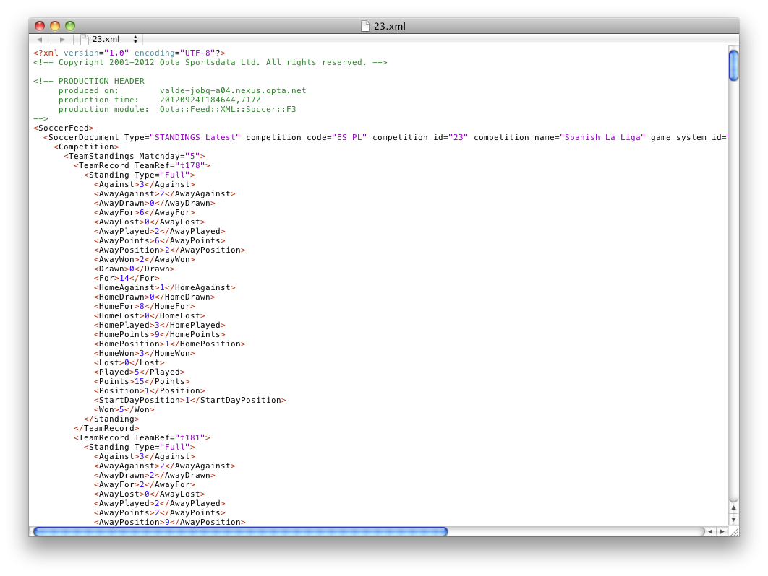
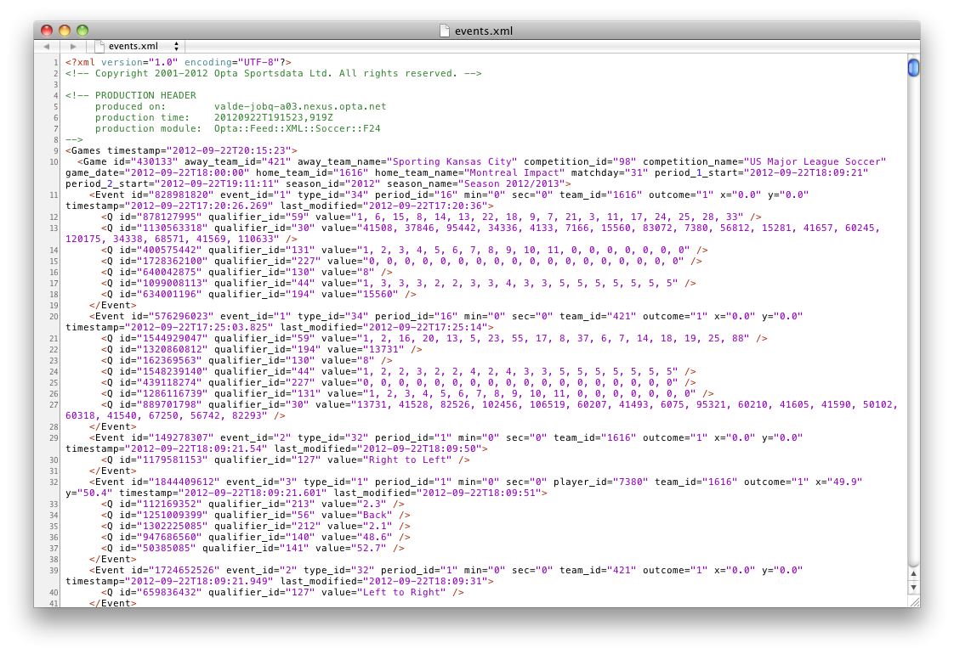

Jermain Defoe's attacking prowess gave his team a boost, and he ended the contest with two goals to his name. His goals came in the 18th and 74th minutes. Defoe ended the game with 15 completed passes and nine total shots.
Tottenham Hotspur ease to win against Reading
Tottenham Hotspur dominated all elements of the game against Reading on Sunday and was rewarded with a 3-1 victory at Madejski Stadium.
Jermain Defoe's attacking prowess gave his team a boost, and he ended the contest with two goals to his name. His goals came in the 18th and 74th minutes. Defoe ended the game with 15 completed passes and nine total shots.
Other goals in the match came on a right-footed shot by Gareth Bale in the 71st minute and a left-footed shot by Hal Robson-Kanu in the 90th minute.
En route to the win, Tottenham Hotspur had the ball for 57.7% of the match. The winners had 23 shots, including eight on target.
Reading enjoyed possession for 42.3% of the loss. They had six shots, including two on target. Adam Le Fondre made his mark on the match after coming on for Jem Karacan in the 45th minute, as he assisted on Robson-Kanu's goal. Jobi McAnuff had two shots for Reading, more than any of his team-mates.
Tottenham Hotspur finished the first half having controlled the ball for 63.7%, with Reading at 36.3%. Tottenham Hotspur also enjoyed a 13-2 advantage in shots during the first half.
The loss continued Reading's recent struggles, which have seen them fail to win a single match this season. Tottenham Hotspur now sit in tenth in the table with a record of one win, one loss and two draws.
The punch line...

Slide 4
How Does It Work?

Slide 5
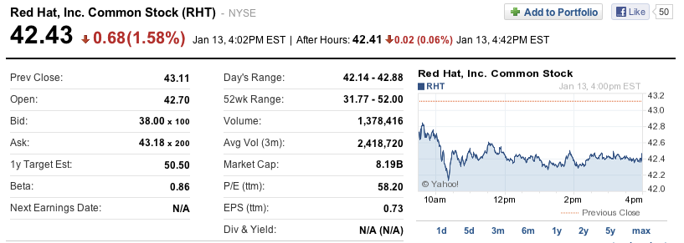
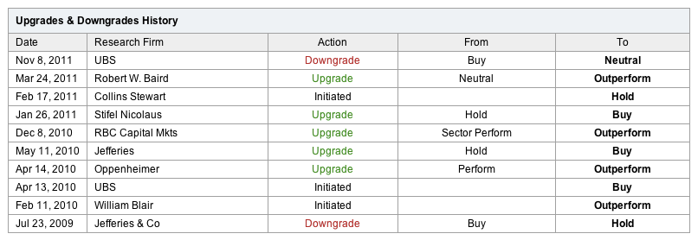

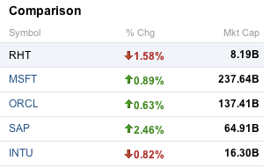
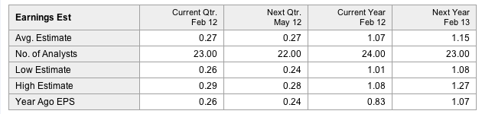
Why Do We Generate Stories?

Slide 6
Narratives Communicate Beyond Data
Over the past eight quarters, AmgenCorp has seen a steady increase in both sales and gross profit. During this period, however, two trends have become apparent.
While sales have increased, there has been a steady decrease in margins which should be cause for concern.
In addition, while we have seen quarter-to-quarter increases in both sales and gross profit, each of these metrics is decelerating, indicating that the business is experiencing a slow down.

Slide 7
With narratives, you just have to read.
With data you have to calculate.
With charts you have to interpret.

Slide 8
Big Data

Slide 9
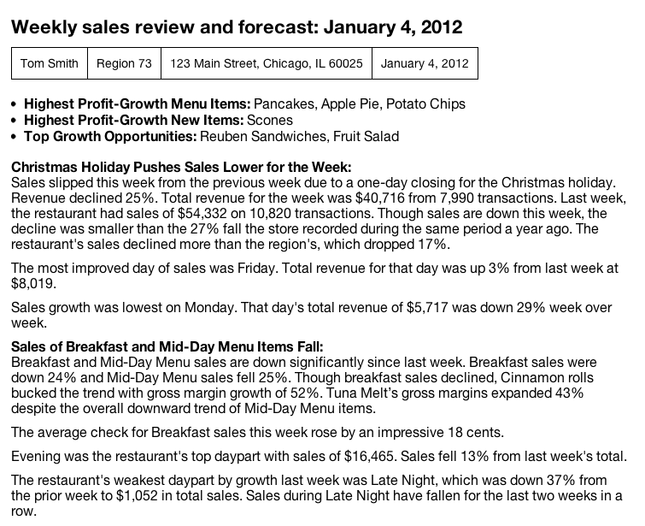
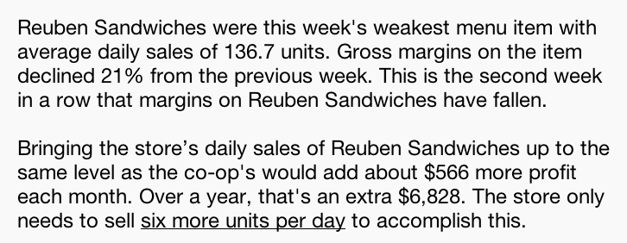
Business Reporting

Slide 10
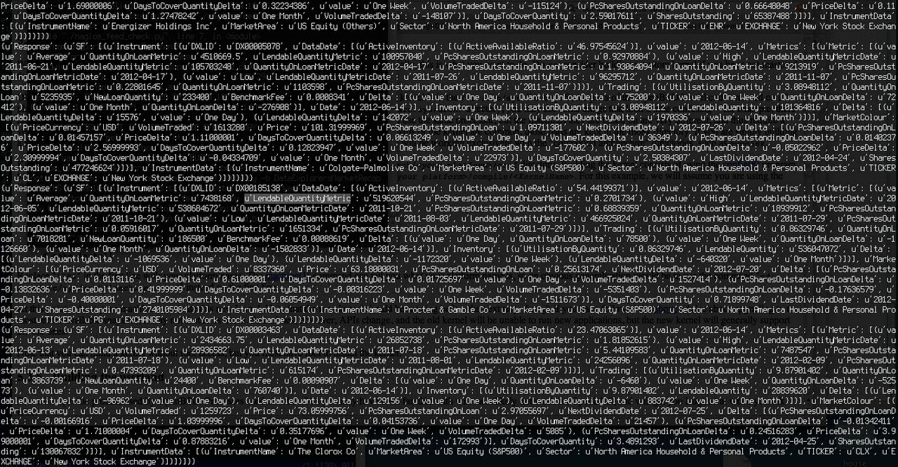
Sector Reporting
MRK (Merck & Co Inc.) erased early losses and rose 0.6% to $31.26. The company recently announced its chairman is stepping down. MRK stock traded in the range of $31.21 - $31.56. MRK's volume was 86.1% lower than usual with 2.5 million shares trading hands. Today's gains still leave the stock about 11.1% lower than its price three months ago.
Thursday, October 6, 2011 12:00 PM: HEALTHCARE MIDDAY COMMENTARY:
The Healthcare (XLV) sector underperformed the market in early trading on Thursday. Healthcare stocks trailed the market by 0.4%. So far, the Dow rose 0.2%, the NASDAQ saw growth of 0.8%, and the S&P500 was up 0.4%.
Here are a few Healthcare stocks that bucked the sector's downward trend.
MRK (Merck & Co Inc.) erased early losses and rose 0.6% to $31.26. The company recently announced its chairman is stepping down. MRK stock traded in the range of $31.21 - $31.56. MRK's volume was 86.1% lower than usual with 2.5 million shares trading hands. Today's gains still leave the stock about 11.1% lower than its price three months ago.
LUX (Luxottica Group) struggled in early trading but showed resilience later in the day. Shares rose 3.8% to $26.92. LUX traded in the range of $26.48 - $26.99. Luxottica Group’s early share volume was 34,155. Today's gains still leave the stock 21.8% below its 52-week high of $34.43. The stock remains about 16.3% lower than its price three months ago.
Shares of UHS (Universal Health Services Inc.) are trading at $32.89, up 81 cents (2.5%) from the previous close of $32.08. UHS traded in the range of $32.06 - $33.01…
The Healthcare (XLV) sector underperformed the market in early trading on Thursday. Healthcare stocks trailed the market by 0.4%. So far, the Dow rose 0.2%, the NASDAQ saw growth of 0.8%, and the S&P500 was up 0.4%.

Slide 11
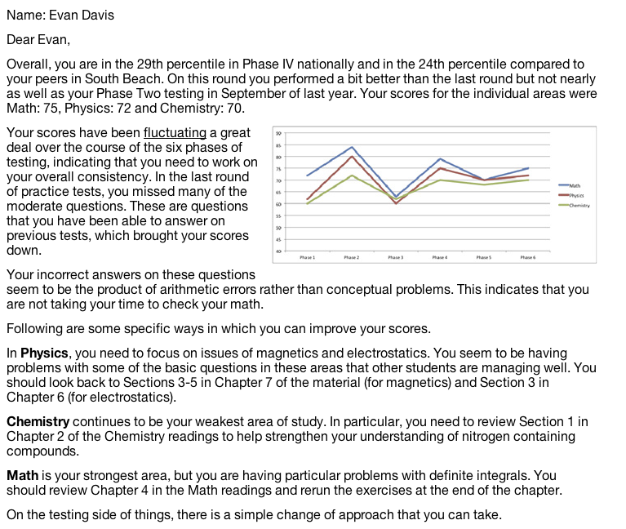
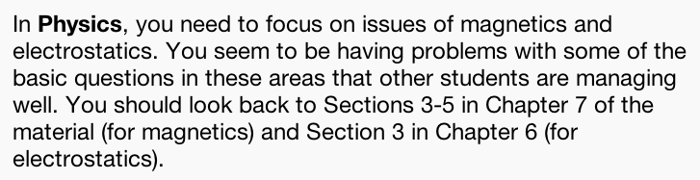
Education

Slide 12
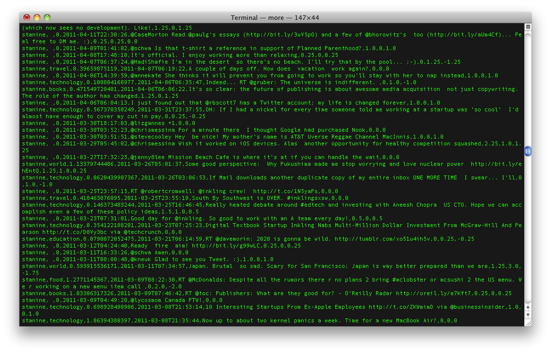
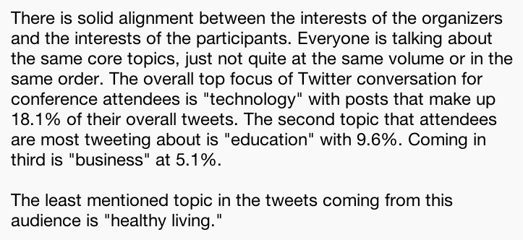
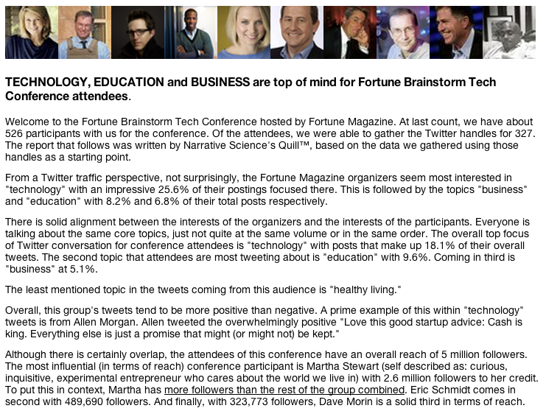
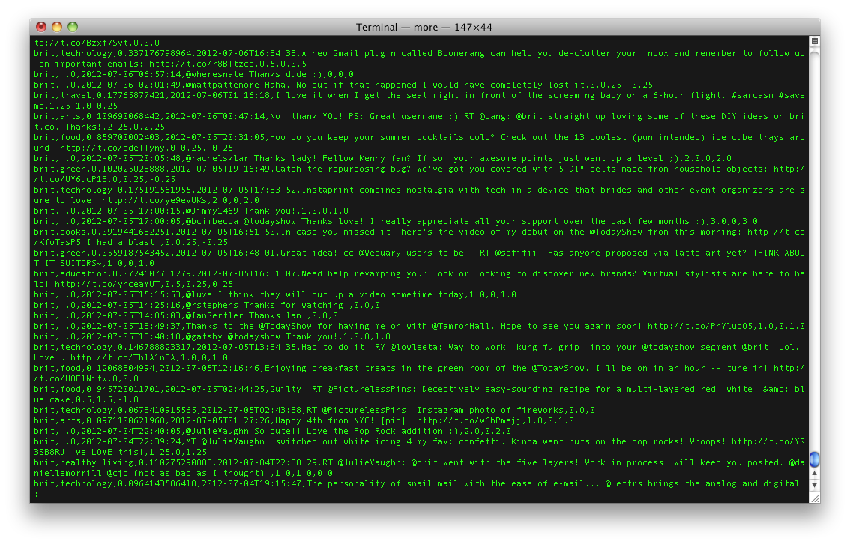
Social (where data isn’t quite data)

Slide 13
The Story is The Last Mile in Understanding Big Data

Slide 14
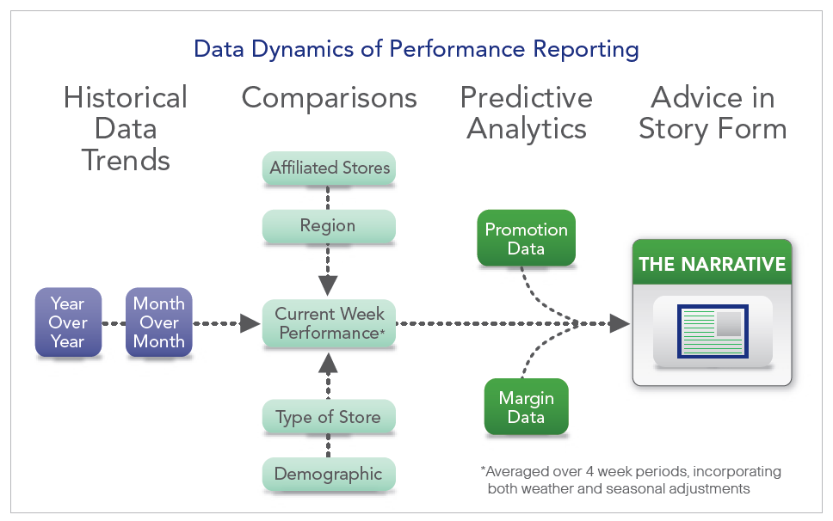
Leveraging the Story

Slide 15
Impact
Immediate and natural communication of data-driven insight with stakeholders
  Clients
  Individuals
  Department Heads
  Executives
Utilization of data assets that are going to waste
Identification of insights that are currently unseen
Powerful amplification of the impact of data generated by automated systems

Slide 16
If You Have Data,
We Can Tell its Story

